Slide 1








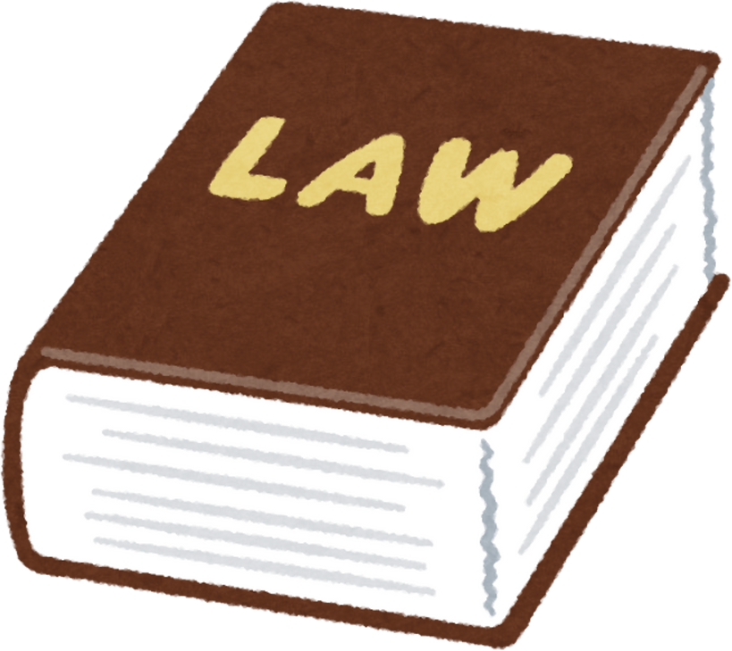
A MULTI-AGENT RAG SYSTEM FOR LEGAL INFORMATION RETRIEVAL IN BANGLADESH
Presented by
MD. SIFAT HAQUE ZIDAN - 2212768042
ABDULLAH AL RAIYAN - 2212712042
RAHIL MEHNAZ - 2121843042
Date of presentation: 10.8.25

Slide 2



PROBLEM STATEMENT
  Legal access gap
  Scattered Information/data barrier
  Generic Ai limit & hallucination
  Lack of accuracy
Basic LangGraph Colab: https://colab.research.google.com/drive/1eI63Xu_d7HrrBrs7iiIqkzkFXgopk1SF?usp=sharing
Colab link w/o link: https://colab.research.google.com/drive/1DlJUUKCwpnZsKG4CqZF3jKz-gT4JNWjm#scrollTo=vKKvaOehbCE-

Slide 3
OUR SOLUTION
2-Agent architecture(built with LangChain):
  Clarification agent to check query clarity & ask follow-up questions
  RAG agent to retrieve from legal corpus
Basic LangGraph Colab: https://colab.research.google.com/drive/1eI63Xu_d7HrrBrs7iiIqkzkFXgopk1SF?usp=sharing
Colab link w/o link: https://colab.research.google.com/drive/1DlJUUKCwpnZsKG4CqZF3jKz-gT4JNWjm#scrollTo=vKKvaOehbCE-

Slide 4

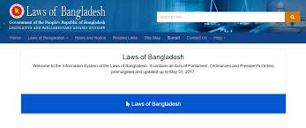
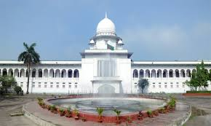
Dataset
Official Website for all Bangladeshi Laws: http://bdlaws.minlaw.gov.bd/act-20.html
Appellate division Case & Judgement: https://www.supremecourt.gov.bd/web/indexn.php?page=judgments.php&menu=00&div_id=1&lang=
BD Law Articles: https://www.bdlawpost.com/
  PDF scraped
  chunked
  embedded
  stored using ChromaDB for fast retrieval

Slide 5
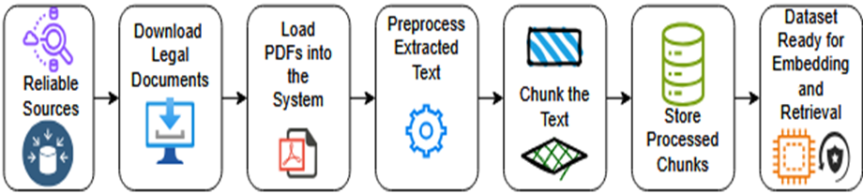
Dataset
Official Website for all Bangladeshi Laws: http://bdlaws.minlaw.gov.bd/act-20.html
Appellate division Case & Judgement: https://www.supremecourt.gov.bd/web/indexn.php?page=judgments.php&menu=00&div_id=1&lang=
BD Law Articles: https://www.bdlawpost.com/
Data Preparation Workflow

Slide 6
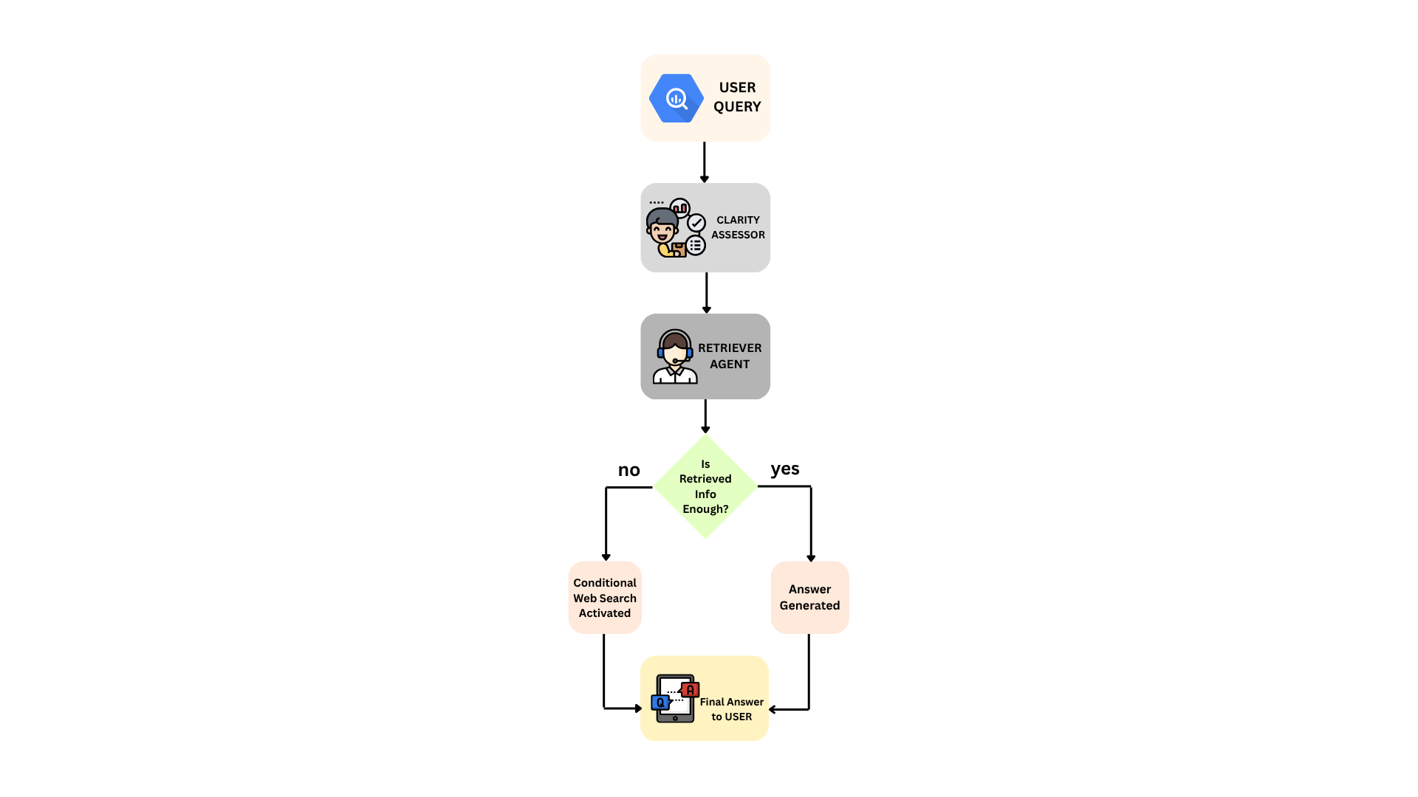




System Workflow
Query received by Clarification Agent
Relevant documents retrieved from vector DB
Conditional web search if corpus is insufficient
Final answer synthesized using retrieved context

Slide 7
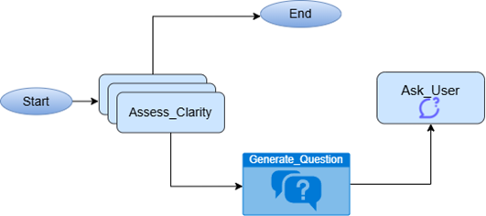
The Agents
  Clarification Agent:
  Assesses query clarity using LLM
  Asks follow-up questions if vague

Slide 8
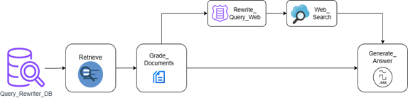
The Agents
2. RAG Agent:
  Retrieves and ranks chunks from vector DB
  Synthesizes answer with source citations

Slide 9
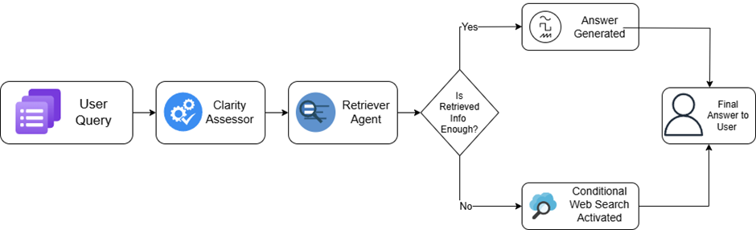
The Agents
  Detailed Agent Workflow

Slide 10
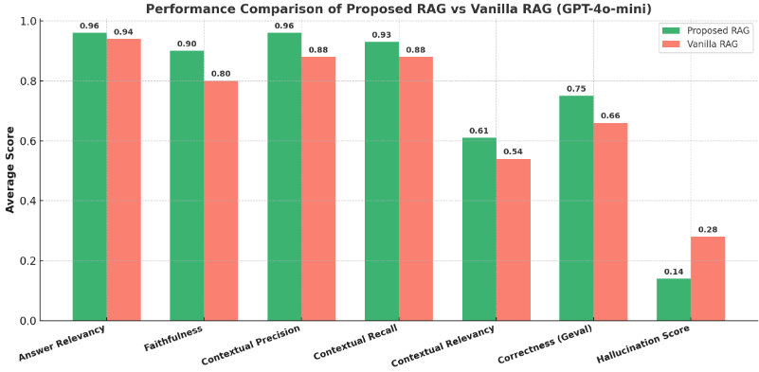
Evaluation & Results
(comparing with existing tech)
  20 BD legal queries evaluated
  Agentic RAG outperformed GPT-4o and Gemma3-4b
  runs offline on Gemma 3B via ollama

Slide 11
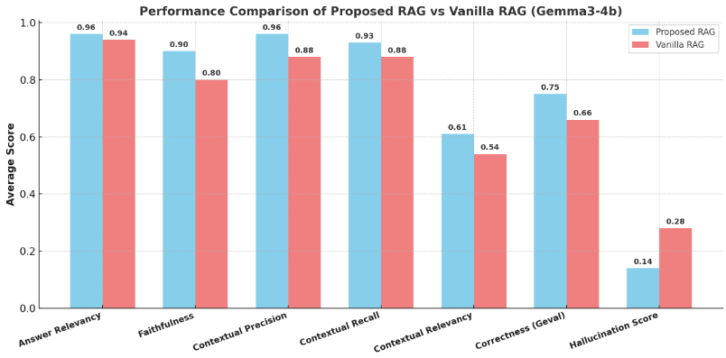
Evaluation & Results
(comparing with existing tech)
  20 BD legal queries evaluated
  Agentic RAG outperformed GPT-4o and Gemma3-4b
  runs offline on Gemma 3B via ollama

Slide 12
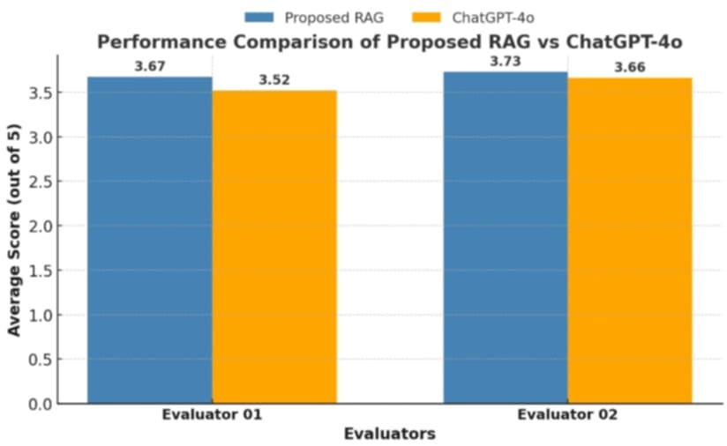
GPT-4o: general, mainly US LAW focused & lacks BD focus
Agentic RAG: domain-specific, offline-ready, low hallucination

Slide 13
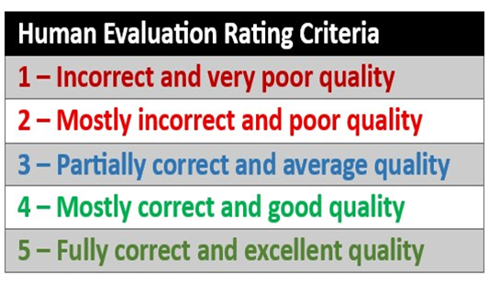
Legal Expert Evaluation Rubric

Slide 14
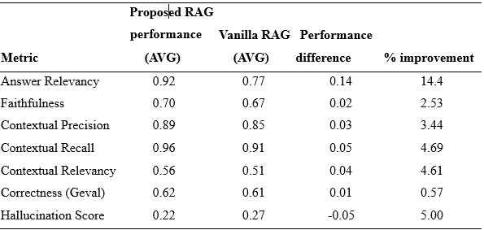
Performance comparison of the proposed RAG system using Gemma34b against the Vanilla RAG using Gemma3-4b.

Slide 15
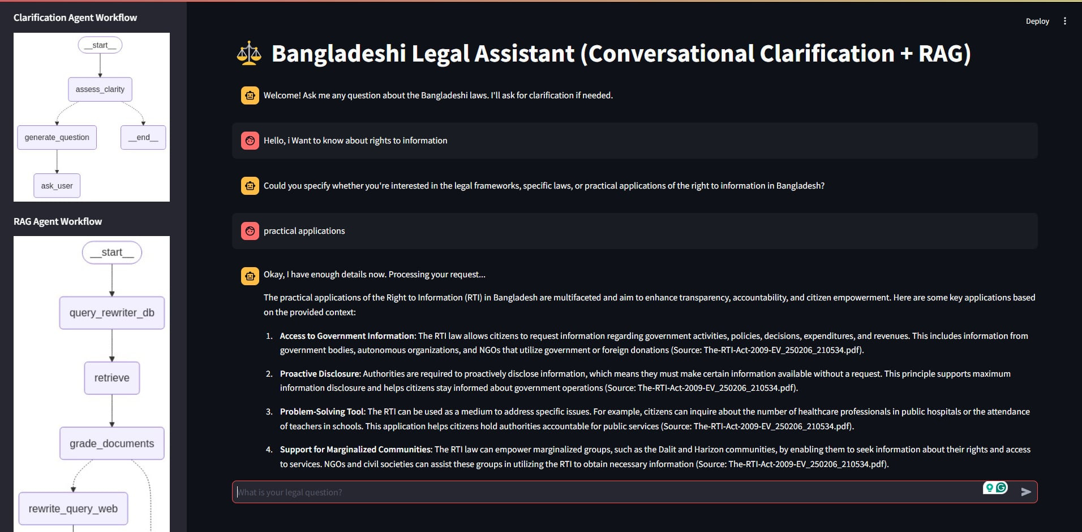

Slide 16
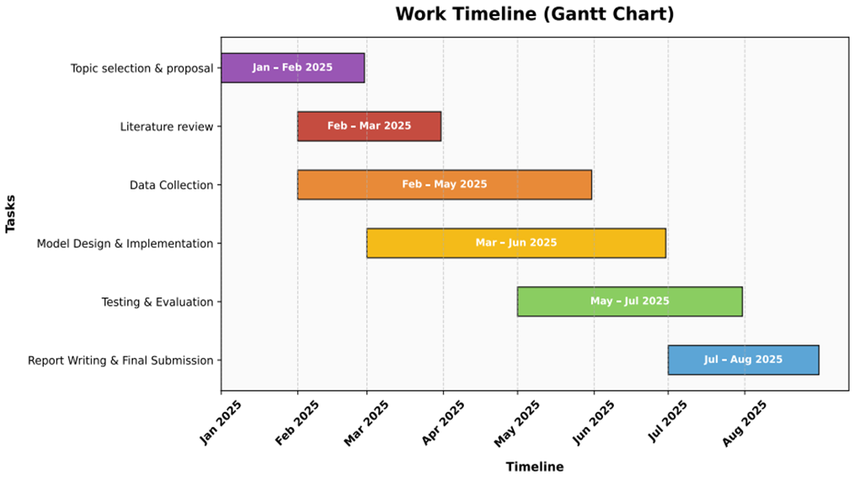
WORK TIMELINE (GANTT CHART)

Slide 17
SUMMARY OF KEY ACHIEVEMENTS
  Progressed from understanding basic RAG to building a sophisticated Multi-Agent system.
  Successfully customized RAG for the niche domain of Bangladeshi Law.
  Explored & implemented Agentic RAG concepts.
  Integrated advanced features: Conditional Web Search, Relevance Checking, and Clarification Questions.
  Developed a functional Streamlit UI for user interaction.
  Helps underserved populations access justice
  Cost effective

Slide 18
FUTURE WORK
  More extensive dataset collection integration
  Exploring different agent roles/specializations

Slide 19
CONCLUSION
A working chatbot was built, tested & validated on both GPT-4o & Gemma3. The evaluation confirms accuracy & relevance.

Slide 20
THANK
YOU

